Slide 1
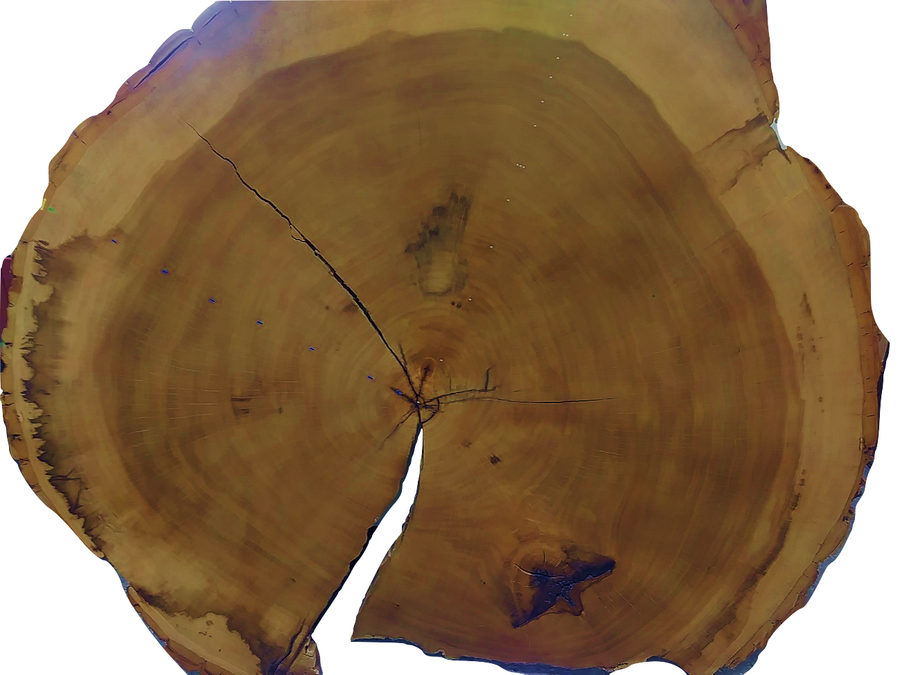

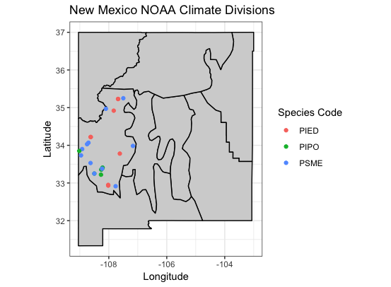


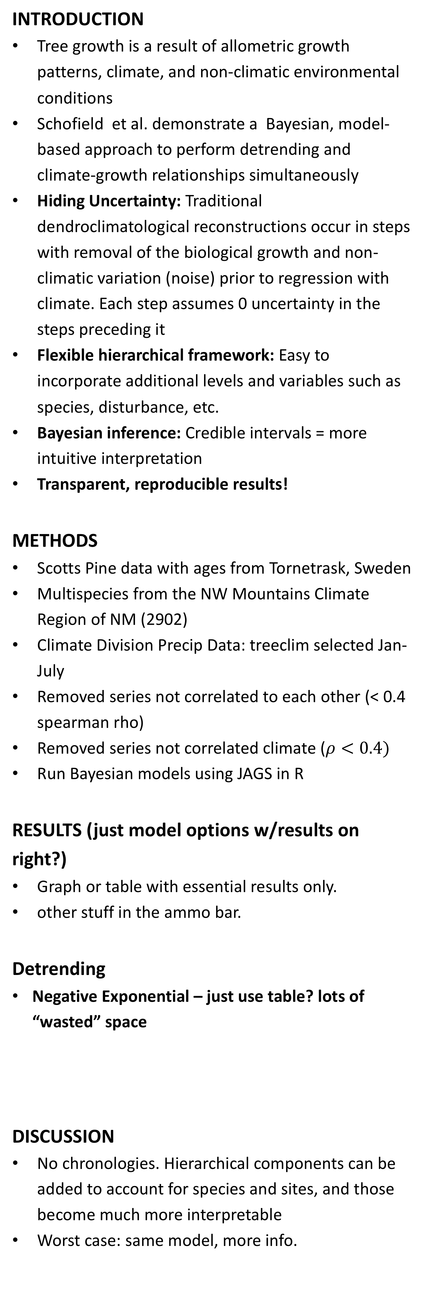
Modeling biological tree growth and climate simultaneously properly accounts for uncertainty and allows for flexible and explicit sub-models of growth and climate Reconstructions are highly dependent on assumptions of climate and climate-growth relationships
Non-Cognitive Predictors of Student Success: A Predictive Validity Comparison Between Domestic and International Students
Non-Cognitive Predictors of Student Success: A Predictive Validity Comparison Between Domestic and International Students
Hierarchical Bayesian models for climate reconstruction and uncertainty using tree-ring data
Daniel J. Hocking djhocking@frostburg.edu
Laura G. Smith lsmit224@vols.utk.edu
INTRODUCTION
Tree growth is a result of allometric growth patterns, climate, and non-climatic environmental conditions
Schofield et al. demonstrate a Bayesian, model-based approach to perform detrending and climate-growth relationships simultaneously
Hiding Uncertainty: Traditional dendroclimatological reconstructions occur in steps with removal of the biological growth and non-climatic variation (noise) prior to regression with climate. Each step assumes 0 uncertainty in the steps preceding it
Flexible hierarchical framework: Easy to incorporate additional levels and variables such as species, disturbance, etc.
Bayesian inference: Credible intervals = more intuitive interpretation
Transparent, reproducible results!
METHODS
Scotts Pine data with ages from Tornetrask, Sweden
Multispecies from the NW Mountains Climate Region of NM (2902)
Climate Division Precip Data: treeclim selected Jan-July
Removed series not correlated to each other (< 0.4 spearman rho)
Removed series not correlated climate ($ρ<0.4)$
Run Bayesian models using JAGS in R
RESULTS (just model options w/results on right?)
Graph or table with essential results only.
other stuff in the ammo bar.
Detrending
Negative Exponential – just use table? lots of “wasted” space
DISCUSSION
No chronologies. Hierarchical components can be added to account for species and sites, and those become much more interpretable
Worst case: same model, more info.
Details for the overly engaged:
Table of test statistics
Table of model options
Figures? Which?
Ring Width = Biological Growth x Climate Response x Error
$$log(rwl_{ikt})=α_{0ik}+α_{1ik}age_{ikt}+β_{k}climate_{t}+ε_{ikt}$$
Detrending | Climate | Climate Relationship | Error
NegExp | Stable | Linear | iid
Mean | Spline (25-yr) | Piecewise linear | Vary by tree
2/3 cubic spline |  | Change point | Vary by species
Hugershoff |  |  | AR1
RCS
Invariant
Partial pooled
NM: NegExp detrend with linear relationship
NM: NegExp detrend with changepoint
NM: NegExp detrend with 25-yr spline
Torne: Spline detrend with linear relationship
Torne: NegExp detrend with changepoint
Model | R2 | Pearson_R2 | RE | CE
Negexp linear | 0.584 | 0.376 | 0.367 | 0.317
Negexp 1change | 0.384 | 0.421 | 0.437 | 0.393
Mean changept | 0.651 | 0.448 | 0.401 | 0.353
Negexp spline25 | 0.683 | 0.362 | 0.277 | 0.220
Torne: NegExp detrend with 25-yr spline
Torne: NegExp invariant with 25-yr spline
Take a picture to visit GitHub page and access code and additional details

Slide 2
Notes: 1. Correct fonts won’t load until you open this in PowerPoint (e.g., if you’re previewing this in your browser it’ll look uglier than it actually is). 2. Generate QR codes here: https://www.qrcode-monkey.com/

Slide 3
FAQ
How do I create a QR code?
https://www.qrcode-monkey.com/
https://www.qrstuff.com/
What if my intro/methods/results doesn’t fit in the silent bar?
If you’re trying to put so much into that bar that it doesn’t fit, they won’t have time to read it anyway. First try moving stuff to the ammo bar. Next, cut cut cut.
Instead of trying to fill space, you’re trying to conserve space.
What if I have a really important graph or picture?
Move the QR Code to the Silent Presenter, then put your graph/image in the middle.

